Slide 1
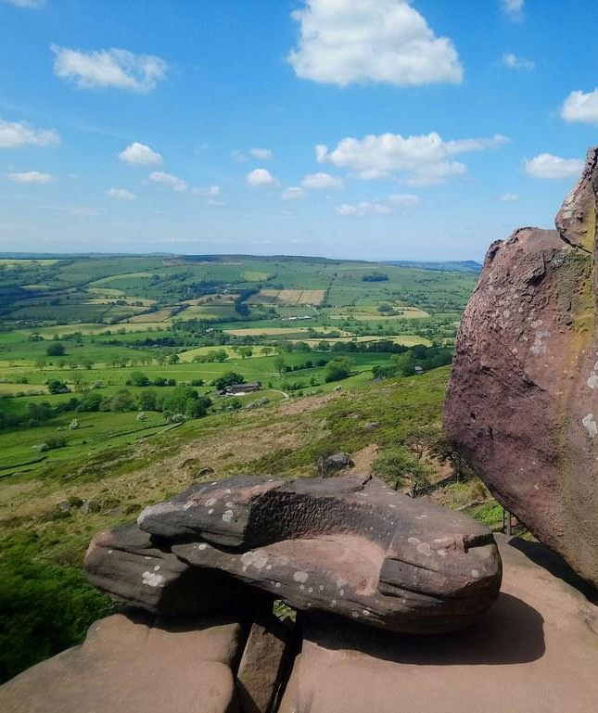
4 March 2025
Introduction to the
Staffordshire & Stoke-On-Trent
Climate Commission
Contacts
Co-chairs
Prof. Zoe Robinson, Keele University and Julian Woolford, Staffordshire Wildlife Trust
Vice-chairs
Kate Copeland, The Globe Group and Judith Smith, Staffordshire Community Energy
Secretary
Tom Bedford, Keele University/The Globe Group
info@staffordshireclimate.com

Slide 2
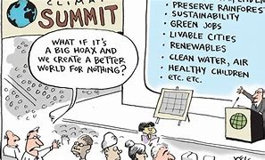
Why?

Slide 3
My ask
What do businesses need?
What can we contribute?
How do we build momentum?
Judith Smith
action@sustainabilitysmith.co.uk
07808 708247

